Slide 1
Video Compression
Chapter 8B
Imran Siddiqi
imran.siddiqi@mcs.edu.pk
Computer Science Department
College of Telecommunication Engineering
National University of Sciences and Technology

Slide 2
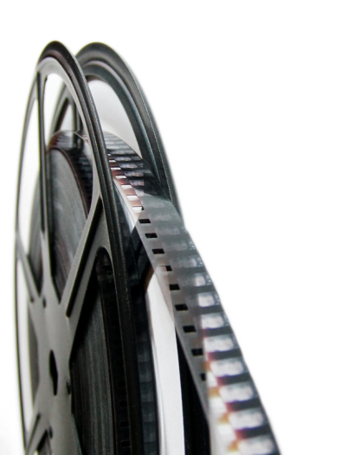
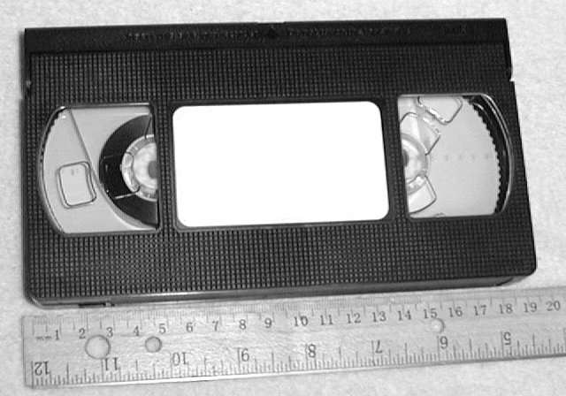
Evolution of Video Mediums
Film
  Invented in late 18th century, still widely used today
VHS
  Released in 1976, rapidly disappearing

Slide 3
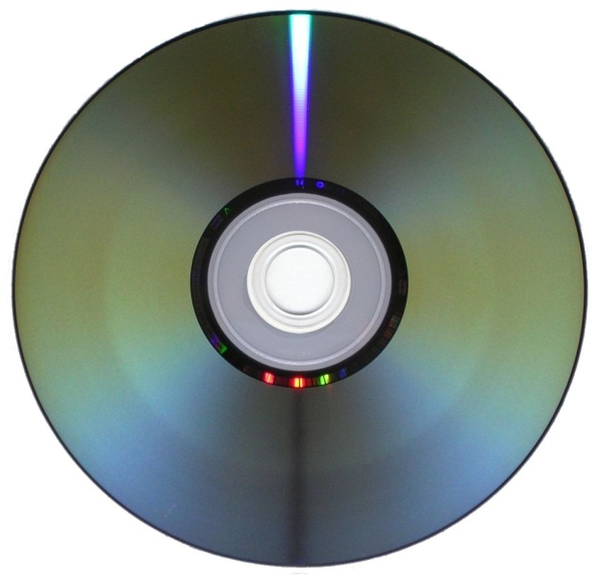
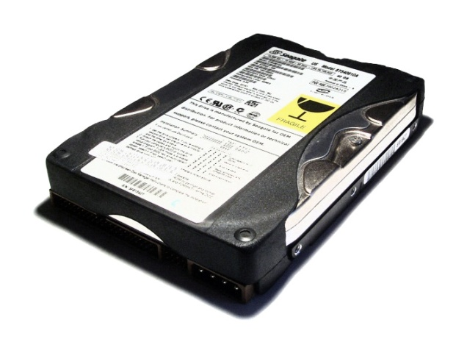
Evolution of Video Mediums
DVD
  Released in 1996, dominant for over a decade
Hard Disk
  Around for many years, only recently widely used for storing video (helped by explosion of Internet)

Slide 4
Video Encoding/Compression
Need to convert analog video to digital format
New digital video cameras have on-board hardware to capture directly to digital format
Once video is in digital format, it makes sense to compress it
Similar to image compression, we want to store video data as efficiently as possible
Again, we want to both maximize quality and minimize storage space and processing resources

Slide 5
Definitions
Bitrate
  Information stored/transmitted per unit time
  Usually measured in Mbps (Megabits per second)
  Ranges from < 1 Mbps to > 40 Mbps
Resolution
  Number of pixels per frame
  Ranges from 160x120 to 1920x1080
FPS (frames per second)
  Usually 24, 25, 30, or 60
  Don’t need more because of limitations of the human eye

Slide 6
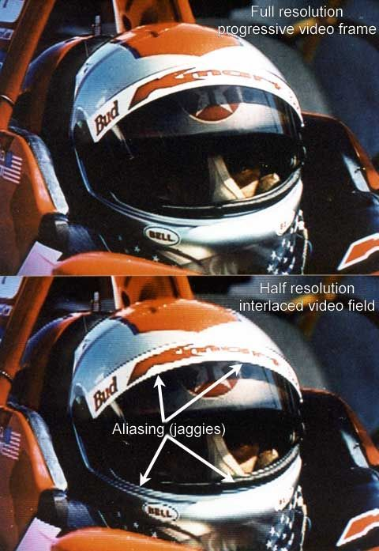
Scan Types
Interlaced scan
  Odd and even lines displayed on alternate frames
Progressive scan
  Display all lines on each frame

Slide 7

MPEG
Leonardo Chiariglione
Moving Picture Experts Group
Established in 1988
Committee of experts that develops video encoding standards

Slide 8
Evolution of MPEG Video Standards
MPEG-1
  Initial audio/video compression standard
  Used by VCD’s
  MP3 = MPEG-1 audio layer 3
  Target of 1.5 Mb/s bitrate at 352x240 resolution
MPEG-2
  Current de facto standard, widely used in DVD and Digital TV

Slide 9
Evolution of MPEG Video Standards
MPEG-3
  Originally developed for HDTV, but abandoned when MPEG-2 was determined to be sufficient
MPEG-4
  Includes support for AV “objects”, 3D content, low bitrate encoding

Slide 10
What is a Movie?
video track
timecode
audio track

Slide 11
What is a Movie?
timecode

Slide 12

Encoding & Decoding
Encoder
Decoder
100111010011
100111010011

Slide 13
MPEG Compression
Takes advantage of
  Spatial Redundancy
  Temporal Redundancy

Slide 14


Spatial Redundancy
Take advantage of similarity among most neighboring pixels

Slide 15
Spatial Redundancy Reduction
RGB to YUV
  Less information required for YUV (humans less sensitive to chrominance)
Macro Blocks & Blocks
  Macro block (16x16) – Block 8x8
Discrete Cosine Transformation (DCT)
  Based on Fourier analysis where represent signal as sum of sine's and cosine’s
  Concentrates on higher-frequency values
  Represent pixels in blocks with fewer numbers
Quantization
  Coefficients are divided by quantization values (given by the JPEG group) and then rounded to the next integer value
Run-Length Encoding
  Compress

Slide 16
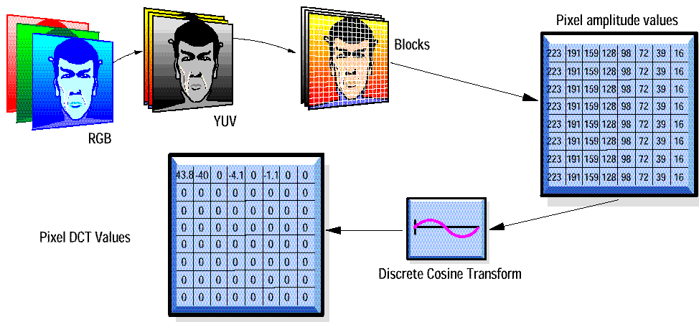
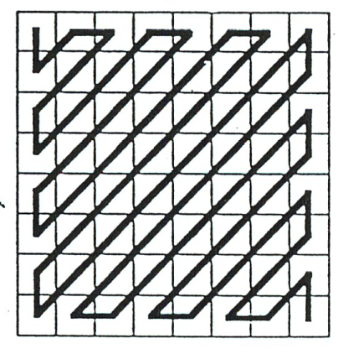
Spatial Redundancy Reduction
Zig-Zag Scan,
Run-length coding
Quantization

Slide 17



Temporal Redundancy
Take advantage of similarity between successive frames
950
951
952

Slide 18
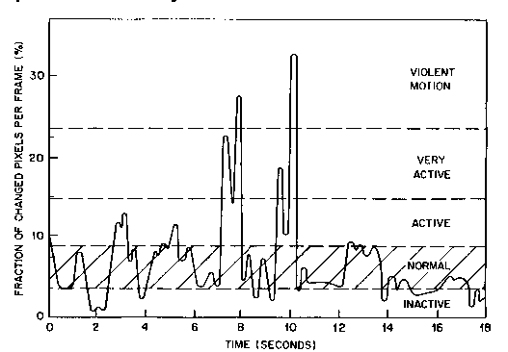
Temporal Activity

Slide 19
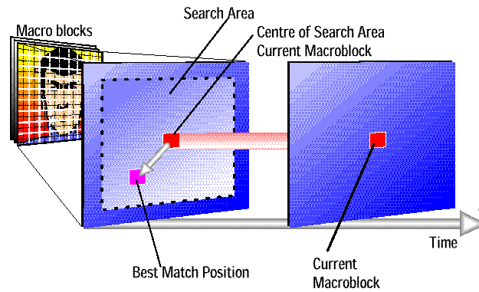
Temporal Redundancy Reduction

Slide 20
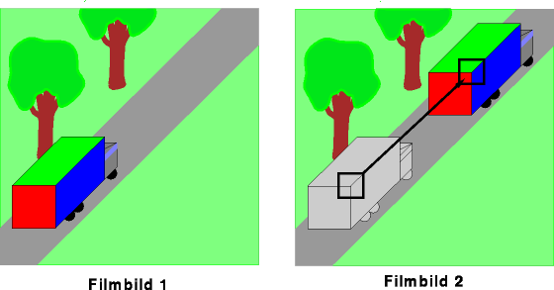
Temporal Redundancy Reduction
Picture 1
Picture 2

Slide 21
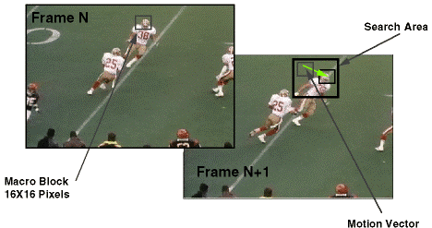
Temporal Redundancy Reduction

Slide 22
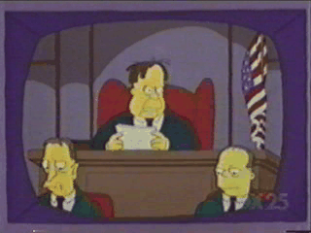
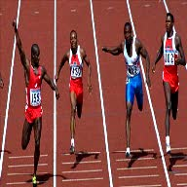
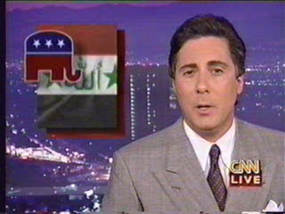
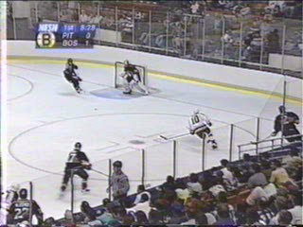
Temporal Redundancy
Many scene changes vs. few scene changes
High Motion

Slide 23
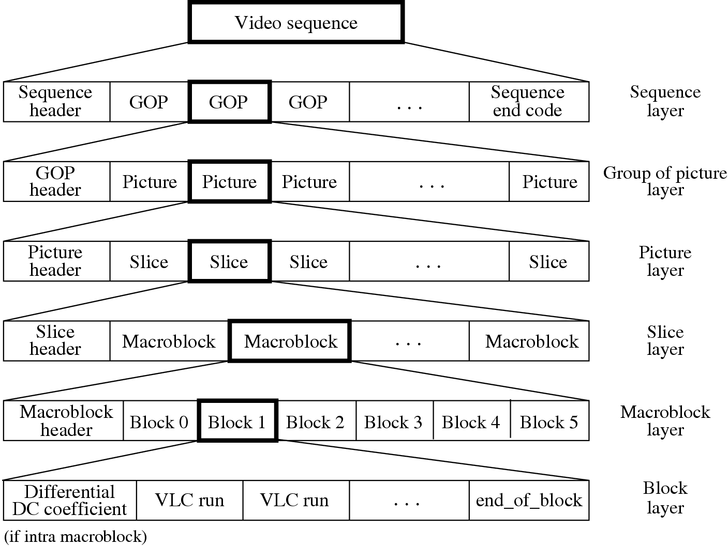
Layers of MPEG1 Video bitstream

Slide 24
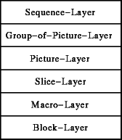
The Block Layer
Picture is divided in 8x8 blocks
The blocks are processed independent from each other
  DCT
  Quantization

Slide 25
DCT & Quantization
Matrix of DCT-coefficients
Coefficients are divided by quantization values and then rounded to the next integer value

Slide 26
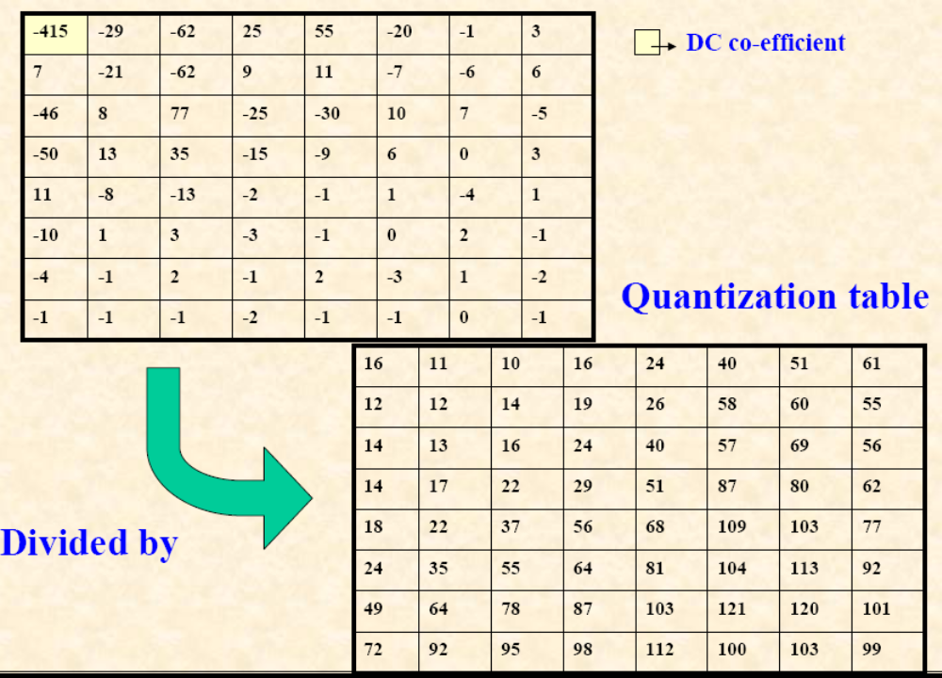
DCT & Quantization

Slide 27
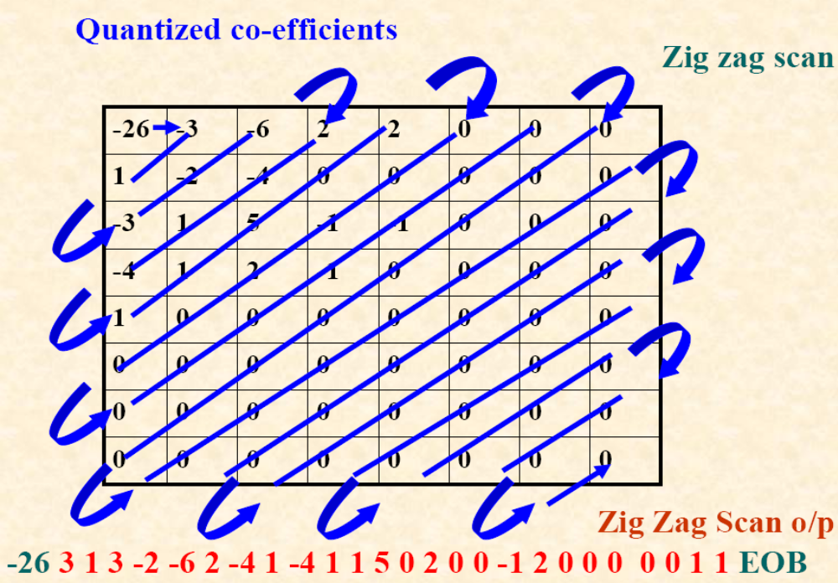
-26 -3 1 -3 -2 -6 2 -4 1 -4 1 1 5 0 2 0 0 -1 2 0 0 0 0 0 1 1 EOB

Slide 28
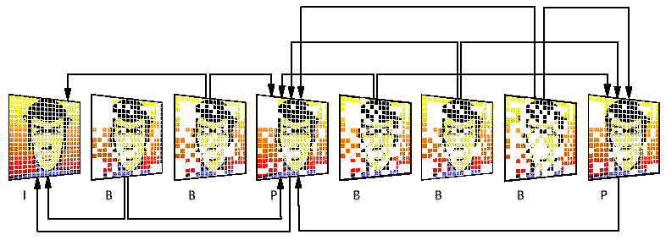
The Macro Block Layer
I frames are independently encoded
P frames are based on previous frames
B frames are based on previous and following frames

Slide 29



The Macro Block Layer
X
Z
Available from earlier frame (X)
Available from later frame (Z)
Y

Slide 30
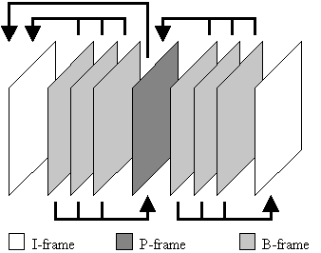
The Macro Block Layer
I – Frame, P – Frame or B – Frame?

Slide 31
The Macro Block Layer
I – Frames:
    Intra coded image
    Highest amount of data
    Coding is very similar to a JPEG picture
    Can be processed independent from other frames

Slide 32
The Macro Block Layer
P – Frames:
    Predicted image
    Medium amount of data
    Difference to some previous frame is stored

Slide 33
The Macro Block Layer
B – Frames:
    Bi-directionally interpolated image
    Lowest amount of data
    Most frequent type of frame
    Depend on the previous or following frames

Slide 34
The Macro Block Layer
I - Frame
P - Frame

Slide 35
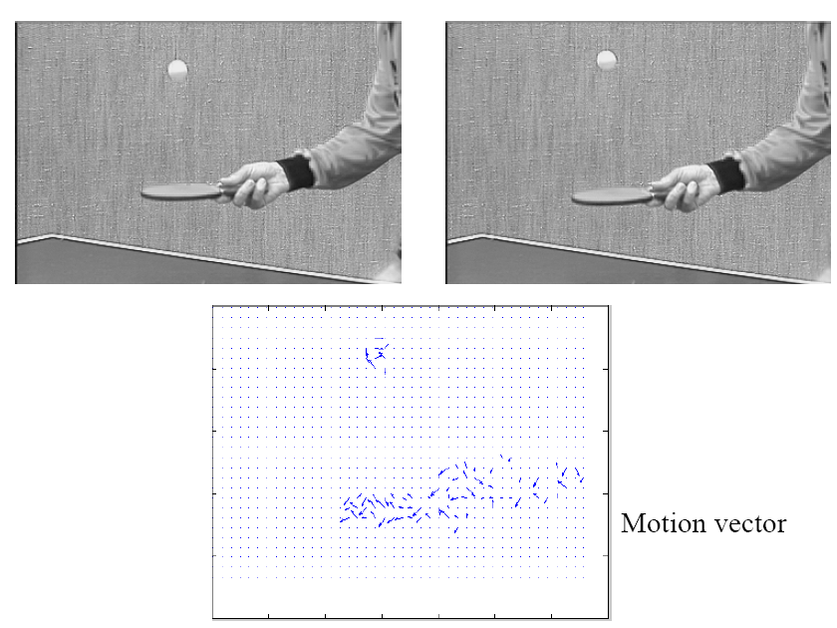
The Macro Block Layer

Slide 36

The Slice Layer
Slices are a group of succesive macro-blocks
Slices in an MPEG-1 Picture

Slide 37
The Picture Layer
Display
I
B
B
P
B
B
P
I
P
B
B
P
B
B
Datastream

Slide 38
The Group of Pictures Layer
Starts with an I-frame
Ends with frame right before next I-frame

Slide 39
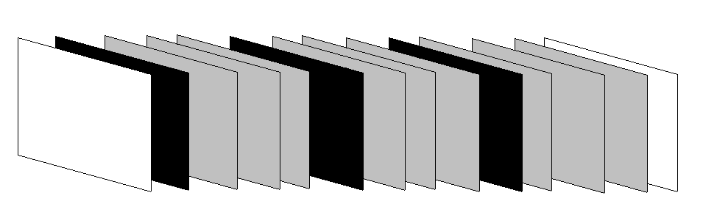
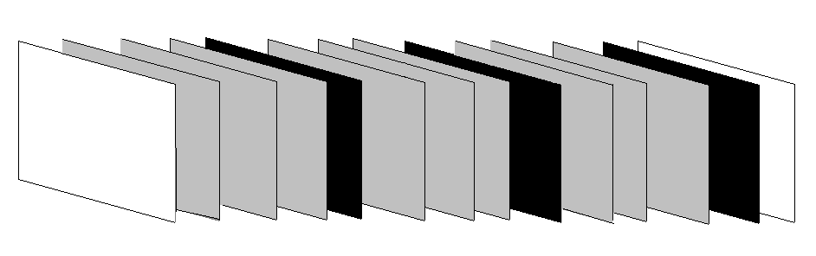
I P B B B P B B B P B B B
1 5 2 3 4 9 6 7 8 13 10 11 12
A typical group of pictures in coding order
I B B B P B B B P B B B P
A typical group of pictures in display order

Slide 40
The Sequence Layer
Union of GOPs
Movie width
Movie height
Framerate (fps)
Bit-rate

Slide 41
Overview of MPEG-4
Besides compression, pays great attention to issues about user interactivities
Object-based coding
The bit-rate for MPEG-4 video covers a large range between 5 kbps to 10 Mbps.

Slide 42
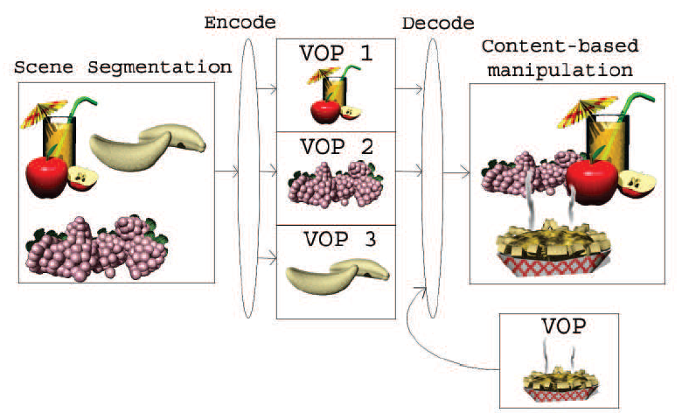
Overview of MPEG-4
Composition and Manipulation of MPEG-4 Videos.
VOP=Video Object Plane

Slide 43
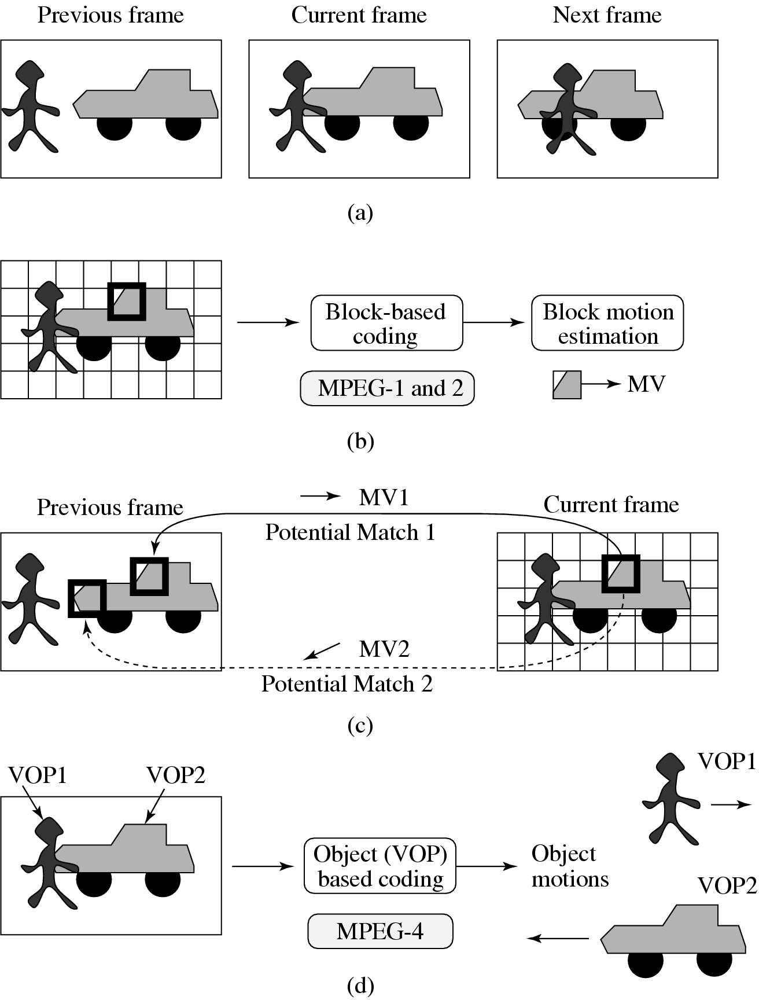
MPEG-4
Comparison between Block-based Coding and Object-based Coding

Slide 44
References
A Handbook of Image and Video Processing - A.Bovik & J.Gibson
MPEG: A Video Compression Standard for Multimedia Applications - Václav Hlaváč CTU Prague
MPEG – Presentation by Sebastian Graf and Thomas Winterscheid
MPEG Video Coding - Li & Drew
Video Compression MPEG - Roger Cheng

